Slide 1

SALES PREDICTION FOR FURNITURE(SOFA)
TEAM MEMBERS Renjarlawar Harini - 22wh1a1250
DNVMSS Harshini - 22wh1a1224
N.Joy Beulah - 22wh1a1223

Slide 2
BENEFICIARIES
MAIN OBJECTIVE
Estimating long term and short term sales.
Help plan finances, marketing, and pricing strategies.
Make business operations more efficient and spot growth opportunities.
TOOLS
End Customer
Product Manufacturer
Supply Chain managers
Selenium Python Microsoft Azure Postman API

Slide 3

PROJECT MODULES

Slide 4
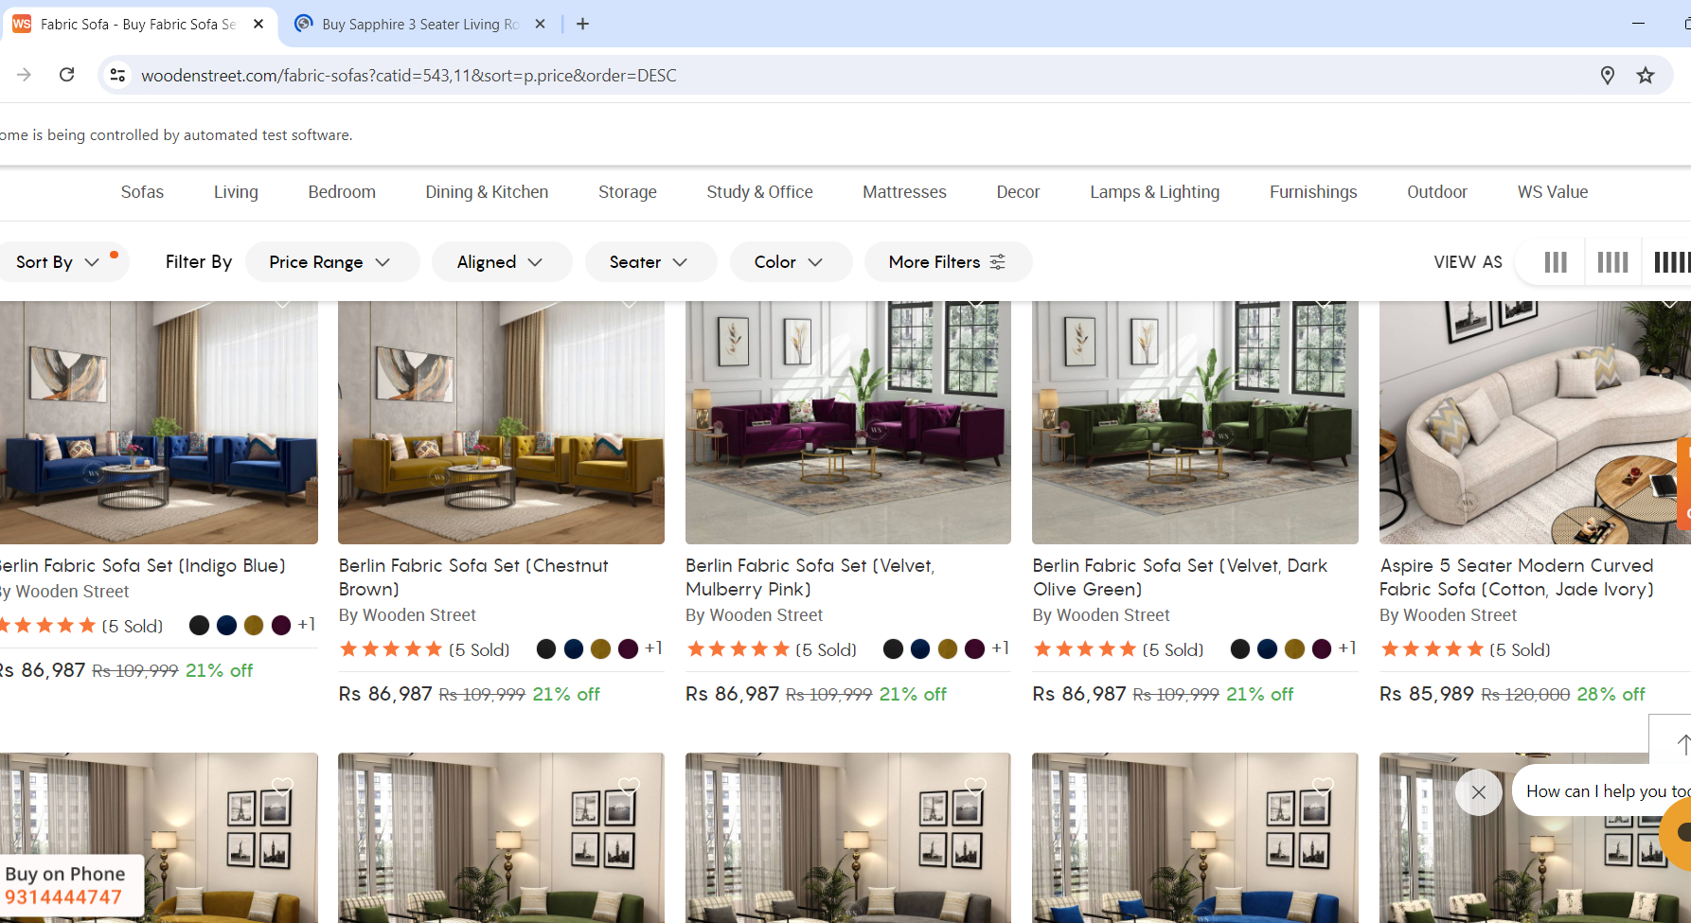
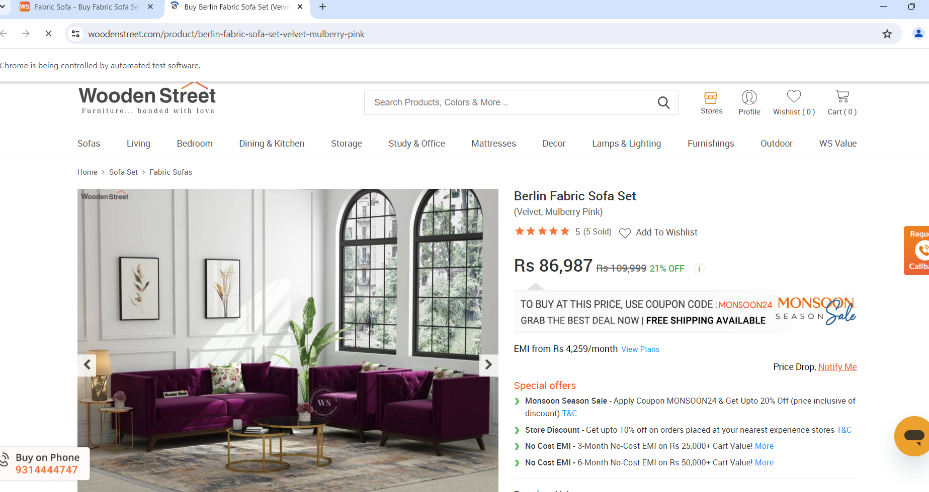
DATA SOURCE

Slide 5
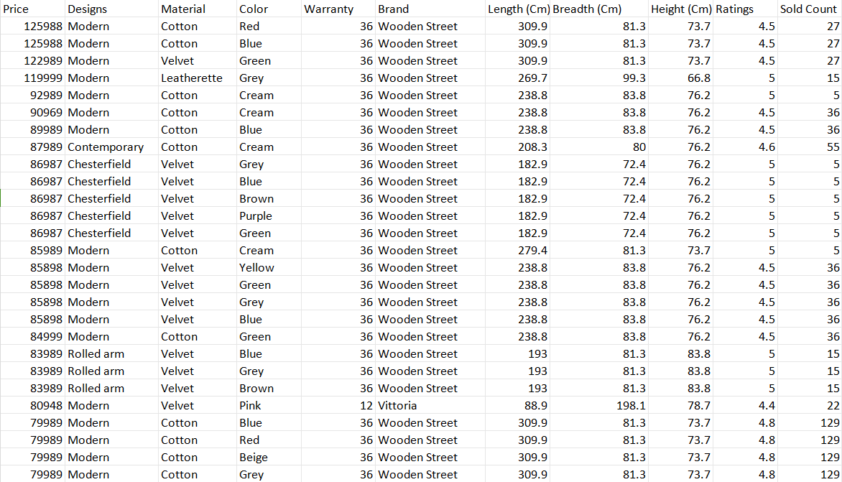
DATASET
Features : 11
Records : 255

Slide 6
DATA PREPROCESSING
Data Cleaning :
Price normalization
whitespace trimming
Dimension parsing
Integer extraction
Missing data imputation
Data Accessibility :
https://docs.google.com/spreadsheets/d/1V2Ge9bdB18mIHAvYs4dPRvP-piysE1sY_76MMxbdoJ0/edit?gid=565367018#gid=565367018
Data Merging:
The script doesn't explicitly merge data, but it combines product details from different pages and tabs into one list. This combined list is then saved as a CSV file for easy access later.

Slide 7
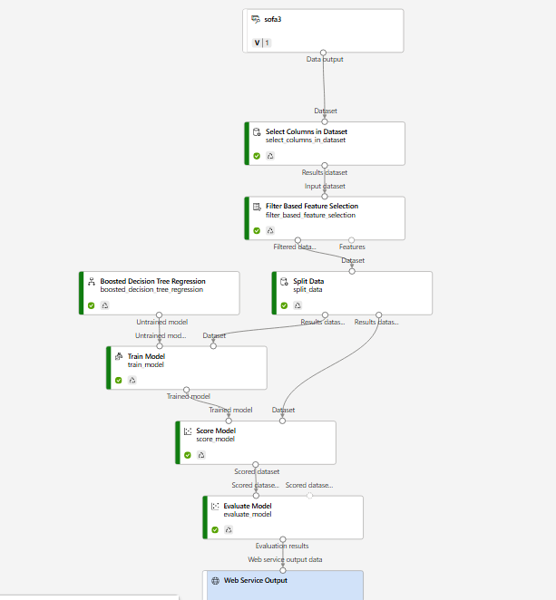
PIPELINE

Slide 8
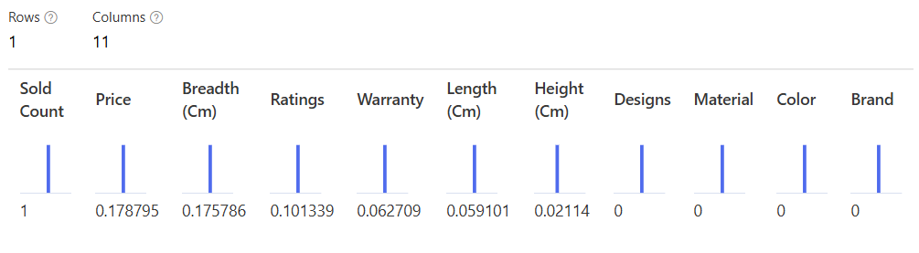
FEATURE ANALYSIS

Slide 9
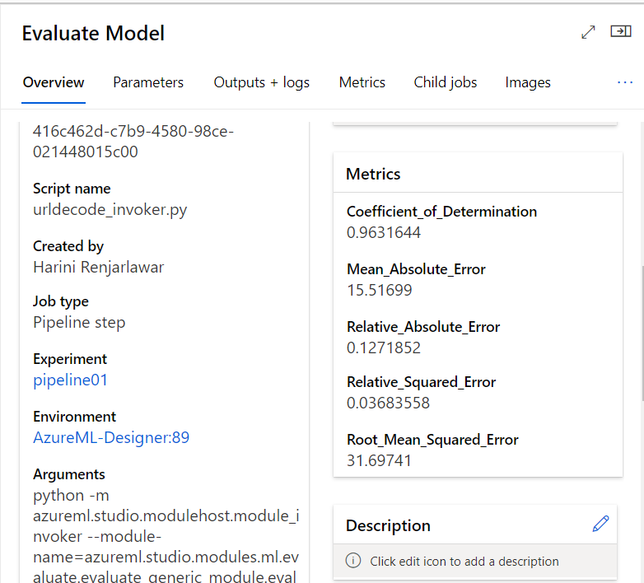
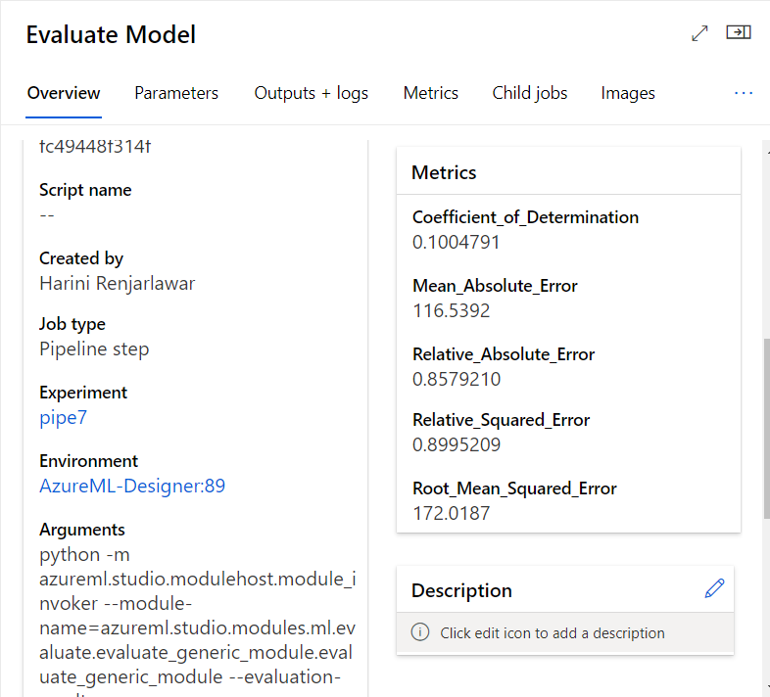
REGRESSION ANALYSIS

Slide 10
EVALUATION METRICS
S No | Algo Name | Relative Mae | MAE | R2 | RMSE
1 | Boosted Decision Tree Regression | 0.1271852 | 15.51699 | 0.9631644 | 31.69741
2 | Decision Forest Regression | 0.1636709 | 0.1636709 | 0.9025420 | 51.55831
3 | Linear Regression | 0.8689353 | 0.8689353 | 0.1030478 | 171.7729
4 | Poisson Regression | 0.8579210 | 116.5392 | 0.1004791 | 172.0187

Slide 11
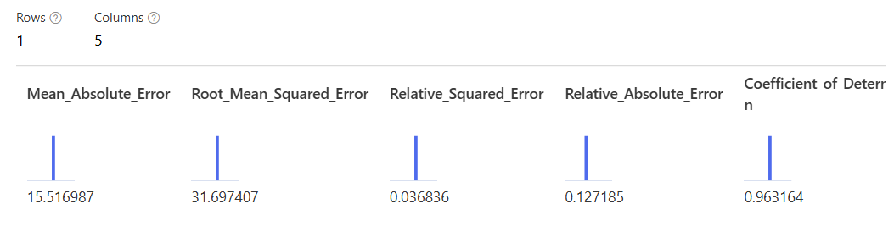
BOOSTED DECISION TREE REGRESSION TRAIN MODEL OUTPUT

Slide 12
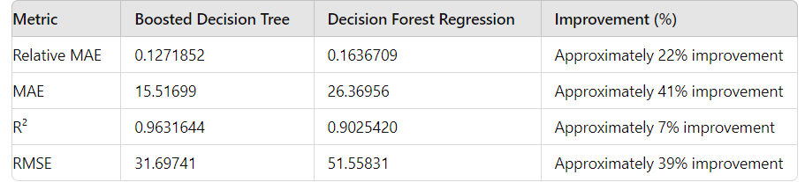
FINE TUNING
Fine-tuning balances model complexity and generalizability, preventing overfitting and ensuring good performance.
OBSERVATION

Slide 13
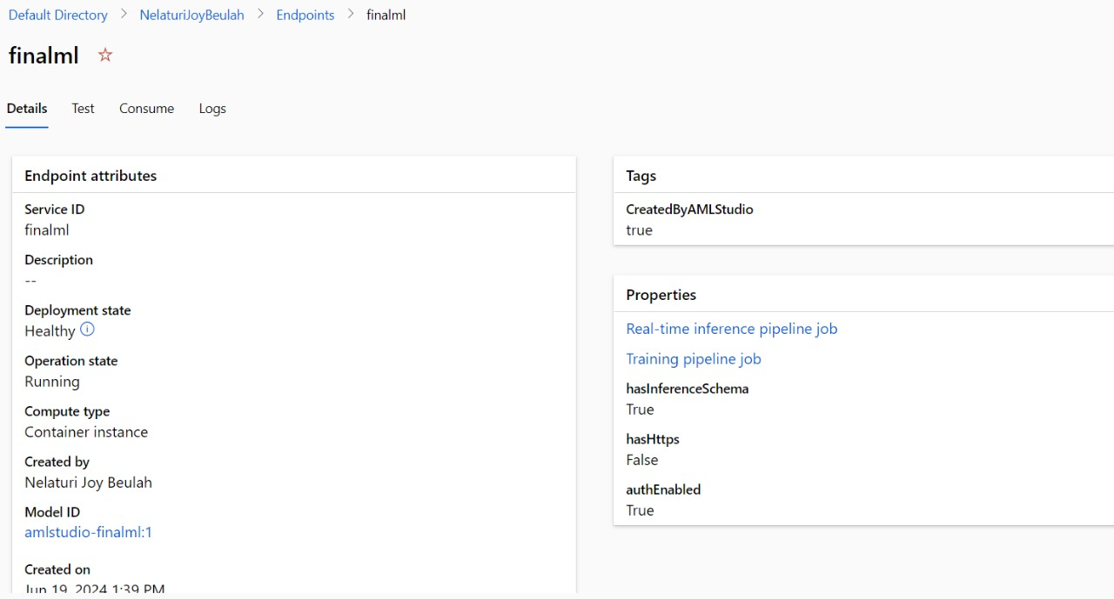
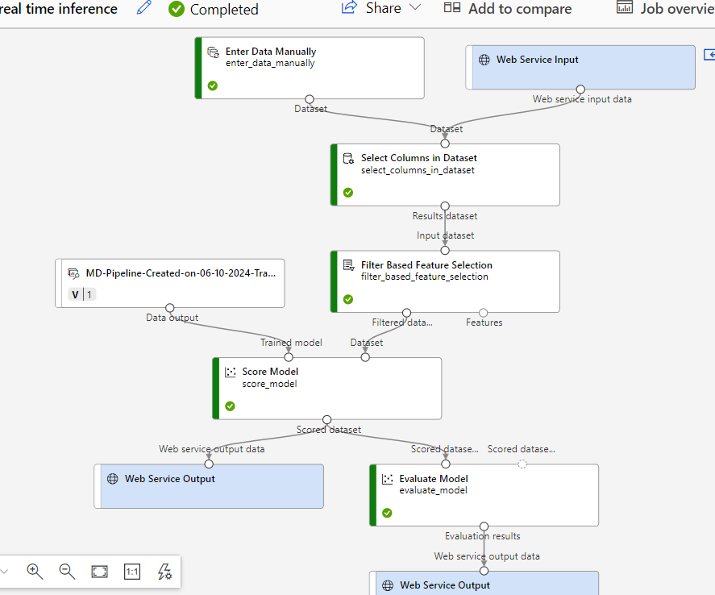
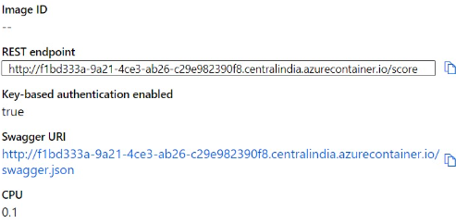
INFERENCE AND MODEL DEPLOYMENT

Slide 14
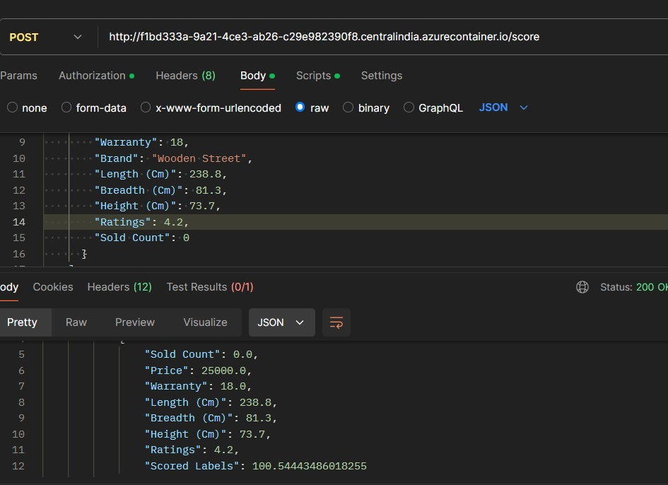
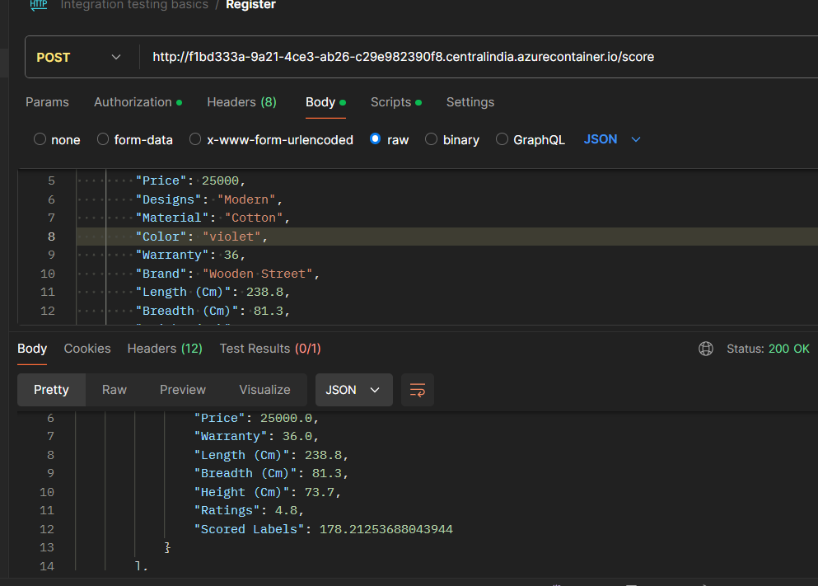
OUTPUT

Slide 15
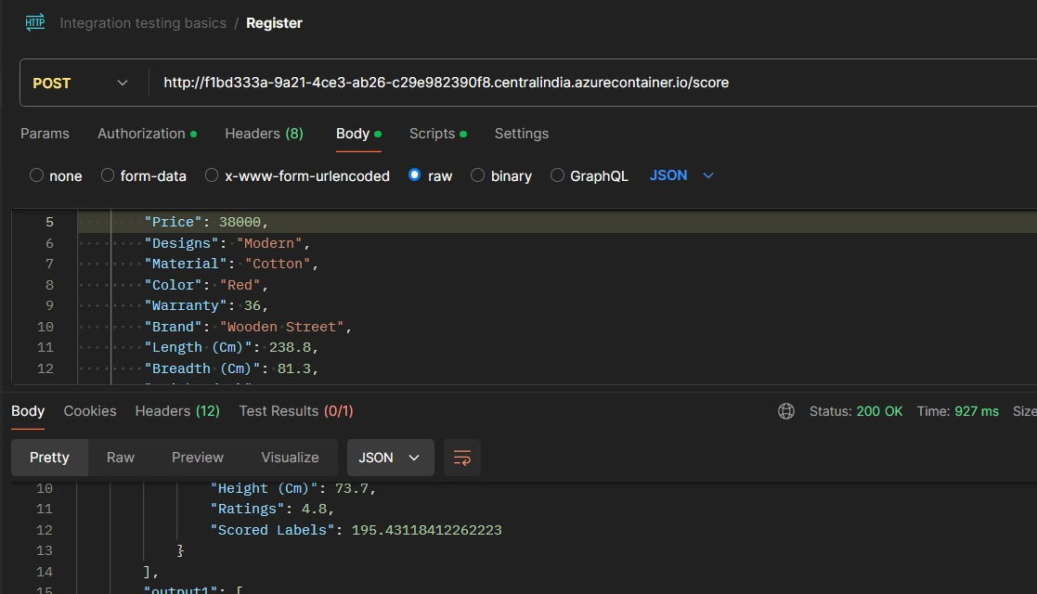
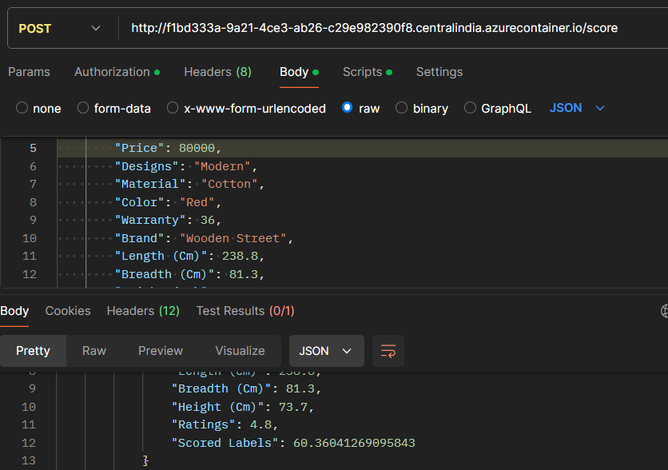

Slide 16
THANK YOU

